Slide 1
Data Insights for Online Retail Store Expansion
Tata Insights and Quants

Slide 2
Introduction
The purpose of this case study is as follows:
Evaluate the factors contributing to the overall business performance globally
Provide insights on the areas which are performing well and suggest different metrics based on the demographic information that would aid in the business expansion decision.

Slide 3
Data Clean-up
Removed the data with the negative values in terms of quantity.
Removed the data with the unit prices below $0.
Also, the blank rows have been removed and revenue column is created by multiplying the quantity with the unit prices.
The data has been cleaned by sorting and filtering out the outliers to provide accurate analysis.

Slide 4
Questions addressed
1) Time series analysis of the revenue data for the year 2011 on the monthly basis.
2) Countries (Top 10) generating the highest revenue along with the quantity sold.
3) Customers (Top 10) generating the greatest revenue.
4) Global demand for products in terms of quantity of products sold.

Slide 5
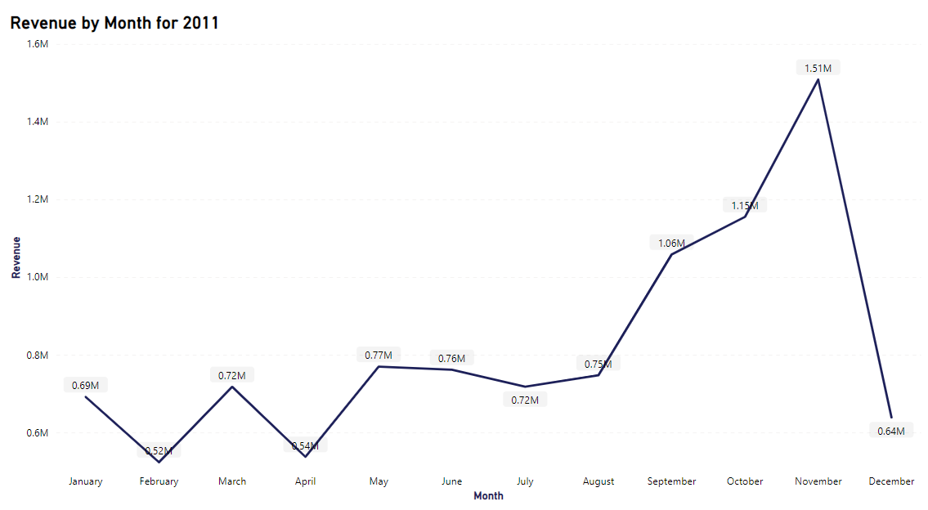
Time series Analysis for revenue
In the time series analysis we see the monthly revenue generated for the year 2011.
As per our analysis, the revenue generated since May has been steady around $0.7million till August.
The revenue peaked up in the latter months of the year from September due to the Christmas season.

Slide 6
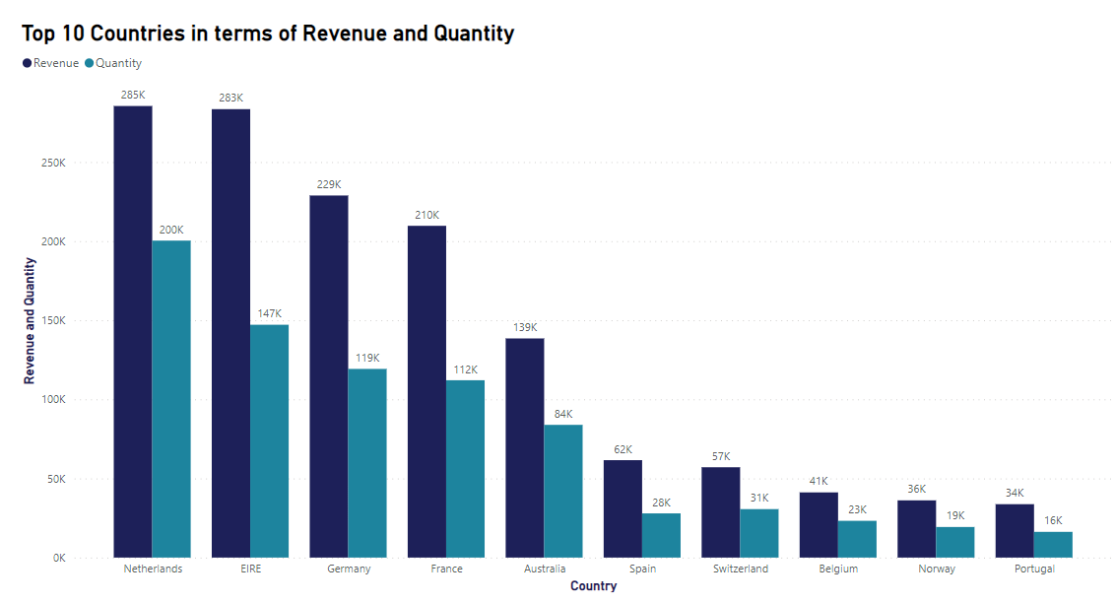
Countries (top 10)
The online retail store is operational in total of 37 countries.
Netherlands rank as the highest country generating the most revenue and quantity of products sold.
Followed closely by EIRE (Ireland), Germany and France.

Slide 7
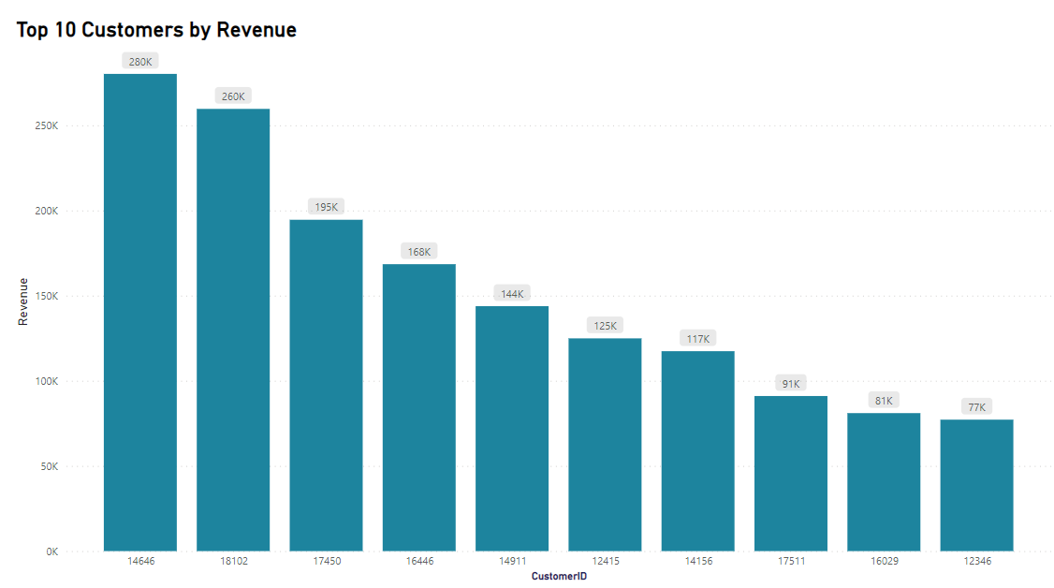
Customers (Top 10 globally)
As per our analysis, the customerID 14646 purchased products worth $280K throughout 2011.
The top 10 customers generate an average revenue of $22k.

Slide 8
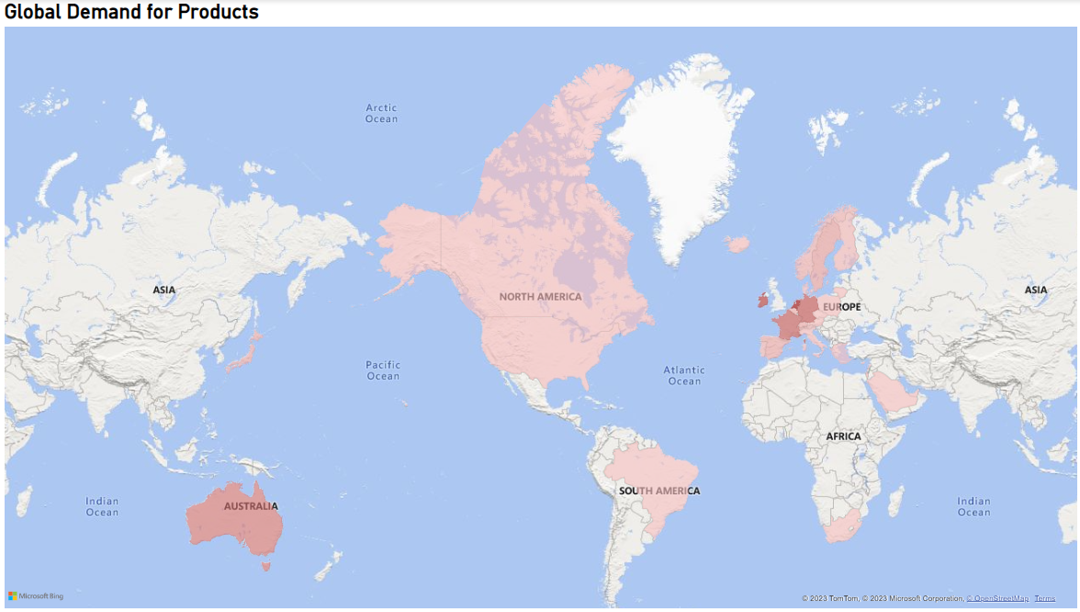
Global Demand for products
Netherlands has the highest revenue making it the best option in terms of business expansion.
The other promising countries for business expansion include like Ireland, Germany and France.

Slide 9
Thank You

